Slide 1


A PATIENT CENTERED HEALTH INFORMATION EXCHANGE SYSTEM

Slide 2


Why is it needed?
To reduce the time required to access the patient’s prior records from the previous healthcare facilities.
For more interoperability and faster transfer of information .
For protecting the patient’s choice of his health records being accessible against his will.
To reduce the time required to access the patient’s prior records from the previous healthcare facilities.
For more interoperability and faster transfer of information .
For protecting the patient’s choice of his health records being accessible against his will.

Slide 3

The last few years witnessed tremendous developments in the field of healthcare technology
Such as transition from paper medical records to electronic health records(EHR).
However a patient centred health information exchange (HIE) system remains a challenge.

Slide 4

MAJOR BARRIERS
The major barriers to a patient-centered health information exchange system are:
Incomplete information
Data breaches caused by unauthorized access of patients health records
Security and privacy concerns that may result in consequences
Data inconsistency.

Slide 5

ENABLING A PATIENT CENTERED HEALTH INFORMATION EXCHANGE SYSTEM.
Through this project we provide a feasible solution to these challenges by utilizing the unique features of blockchain

Slide 6

WHY BLOCKCHAIN?
Blockchain is a specific type of database.
It differs from a typical database in the way it stores information; blockchains store data in blocks that are then chained together.
As new data comes in, it is entered into a fresh block. Once the block is filled with data it is chained onto the previous block, which makes the data chained together in chronological order.
Decentralized blockchains are immutable, which means that the data entered is irreversible.

Slide 7
ADVANTAGES OF USING BLOCKCHAIN TO STORE INFORMATION
Blockchain is a decentralized, (distributed ledger) means of storing data, thus the need for a centralized repository or cloud storage is overcome
Data once entered cannot be tampered with (it is “unhackable”)
Privacy and security is ensured

Slide 8
Solution Proposal
To overcome the current barriers to a patient centred HIE , blockchain technology can be utilised.
We propose a blockchain model to protect the data security and patient’s privacy and provide patients full control over their health records.
Utilising smart contract features (a programmable self executing protocol running on blockchain), personalizing data segmentation and an allowed list for doctors to access data, this model achieves patient centric HIE.

Slide 9
Solution description
We propose a private Ethereum blockchain system with multiple smart-contract functions.
The system architecture contains two modules:
(1) The Linkage module: a system administrator from each healthcare facility will create a touchpoint for each patient's visit after the EHR is ready and input the related primary information into a smart contract for future indexing
(2)The Request module: patients grant clinicians permission to access their data by adding clinicians to the “allowed list” in the smart contract. Clinicians can select records through the touchpoints after being granted access to the patient's records without identifying the hospitals storing those records.

Slide 10
ENVIRONMENT SETUP
Each healthcare facility is required to provide at least one node (any computer or a mobile phone)
Each node requires a blockchain adaptor to communicate with the system and the steps to be followed are
Deploy the correct genesis block which is a JSON file with the blockchain’s unique characteristics, add the starting node as a peer node
Build a remote procedure call server to communicate with servers outside the adaptor
Build a receiving database outside the firewall to store the data from other blockchain adaptors
These steps are embedded into an installation file that can automatically convert a node into a blockchain adaptor.Once the healthcare facility has built a blockchain adaptor, the adaptor will generate a blockchain account which is a hash of the user's public key

Slide 11

When a patient visits the facility for the first time, the system administrator registers a blockchain account for the patient which automatically generates a global ID (public key) based on the blockchain account.
The system architecture contains two modules: the Linkage Module and the Request Module

Slide 12
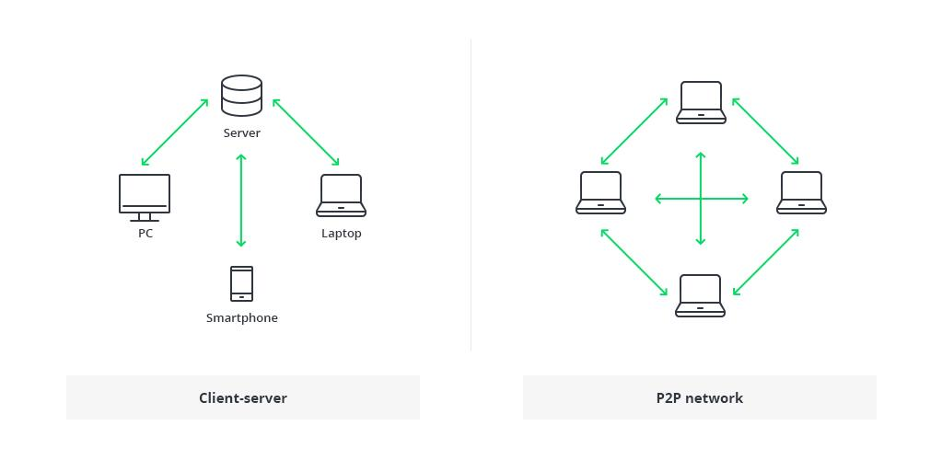
Linkage Module
Once the EHR is ready, the facility’s adaptor will hash the entire visit record in a JSON file and store the hashing value in the smart contract along with the touchpoint before the EHR data is stored in the secure database.
Using the smart contract to store the touchpoints can enhance its’ security, make it immutable and anonymous

Slide 13
Request Module
In case of an emergency where many physicians are involved,the healthcare facility will be assigned an umbrella account in the blockchain that links to all clinicians involved.
The addition of the umbrella account to the “allowed list” by the patient could grant the physicians a one-time access to the records.
Upon receiving consent the following steps take place
Physician confirms their addition to the “allowed list”.
Receiving touchpoints from smart contract.
Selecting the required touchpoints
The touchpoint selections are sent to the smart contract through the healthcare facility's blockchain adaptor
The smart contract uses the recipient's healthcare facility's adaptor to request the selected records chosen from the remote healthcare facilities’ adaptors

Slide 14
6 The remote healthcare facilities query the records inside their EHR systems.
7.All selected EHR data is dynamically encrypted by the remote healthcare facilities’ adaptors and temporarily stored outside the clinician's facility's firewall; the encrypted data's locations and hash values are sent to the receiving database in the adaptor of the clinician's facility
8.The remote healthcare facilities’ adaptors will automatically encrypt the decryption keys with the recipient's public key and send the encrypted decryption key to the smart contract.
Any modification of the data from the original source, or in the transition, will result in a mismatch of the hash and the record will send an alert in red font

Slide 15
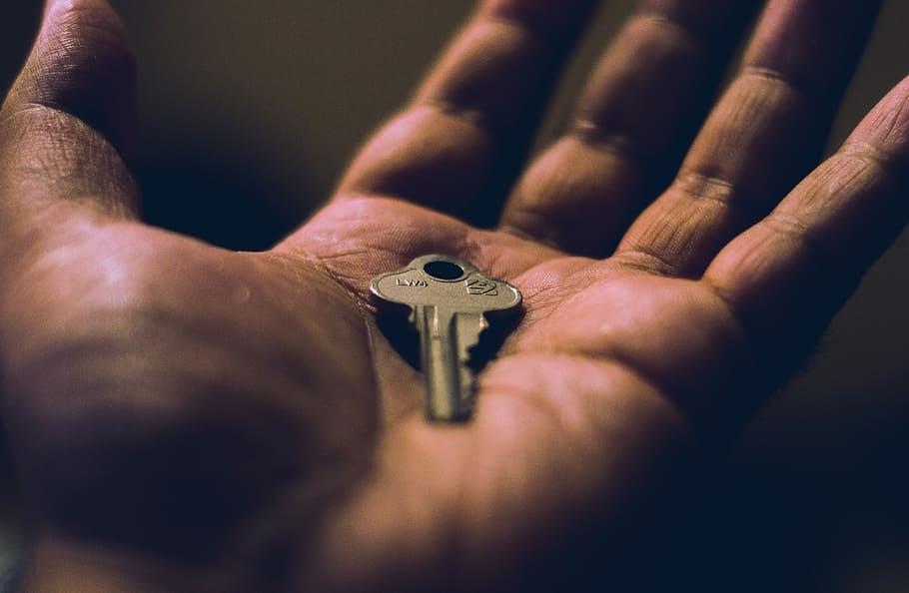
HOW IS SECURITY ENSURED?
HOW IS SECURITY ENSURED?
Public key cryptography is used to create and manage health identities. In public key cryptography, a pair of mathematically related public and private keys is used to create digital signatures and encrypt data. Since it is computationally infeasible to obtain the private key given its paired public key, these public keys can be shared freely, thereby allowing users to encrypt content and verify digital signatures. In contrast, private keys are kept secret to ensure only their owners can decrypt content and create digital signatures.

Slide 16
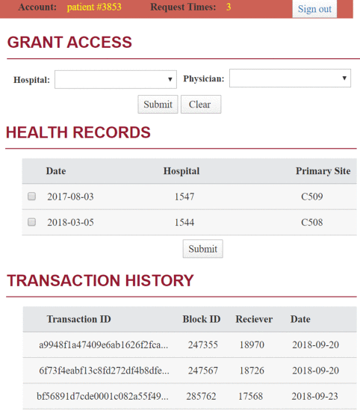
A MODEL USER INTERFACE FOR GRANTING PERMISSION

Slide 17
The workflow for accessing a data source is outlined in the following steps :
The user first authenticates via the UI, and when successfully authenticated data access request can be input to the system;
UI forwards user's request to the server;
The server queries BC for current user's access token(s);
When permission is valid, the server decodes the access token(s) with correct keys supplied by user and uses the decrypted reference pointer to obtain actual data from the DB connector to the proper database;
When data has been retrieved from the data source via DB connector, the server updates UI to display data in a readable format.
The workflow for updating data access is :
A user first authenticates through the user interface (UI), and when successfully authenticated, data access permission request can be input to the system;
The UI forwards users request to the server;
The server logs permissioned or revoked access in the blockchain component (BC); and
The server updates UI with proper response to notify the user.

Slide 18
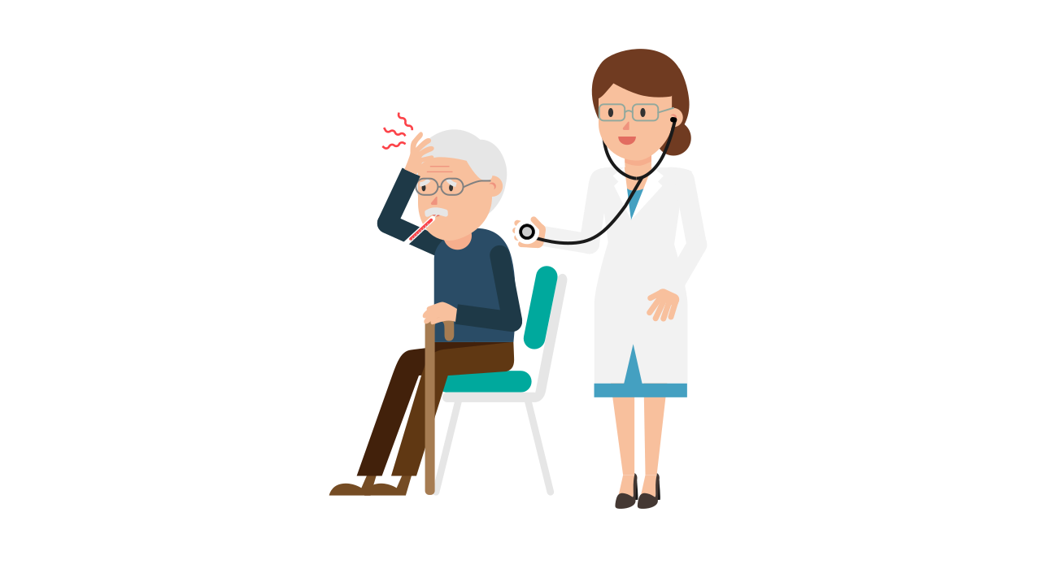


When a patient opts into the blockchain system for the first time ,the system administrator creates a blockchain account for the patient. The EHR of the patient will be stored in this blockchain account.
For any further visits of the patient to the same or a different hospital,he/she can grant the physicians access to EHR through this blockchain account.Thus patient can control with whom to share health records.

Slide 19
Admin
Patient opts into blockchain for the first time
Registers blockchain account,generates global ID
Hashing value is stored in the smart contracts with touchpoints & EHR data is secured.
When patient visits another facility
Encryption and decryption takes place between the 2 nodes and upon establishing secure connection data is exchanged
Selections sent to smart contract
Clinicians receives touchpoint list and selects relevant touchpoints.
Facility is assigned an umbrella account through which physicians can access records with patients consent

Slide 20

Smart Contracts
Smart contracts are lines of code that are stored on a blockchain and automatically execute when predetermined terms and conditions are met.
Smart contracts can store touchpoints, which contain brief information such as primary diagnosis and treatments for each visit. Clinicians can select from the touchpoint list to request appropriate data for the current visit instead of filtering information after receiving all the patient's previous records. Patients can also perform personalized segmentations on the touchpoints to select the information they would like to keep confidential.

Slide 21
Why it’s better than existing solutions
Traditional methods
Blockchain
1
Identity matching is difficult
Public/Private key used to represent identities
2
Data inconsistency
Immutability feature ensures data consistency
3
Locating healthcare facilities to collect consented info.
Smart contracts store touchpoints that are easily accessible
4
Security concerns
Unhackable peer to peer networks

Slide 22
CONCLUSION
We setup the framework for a practical blockchain system to achieve patient centric HIE. The framework involved:
1)Blockchain adaptor setup
2)Two layers of security settings
3)Hashing mechanism for data consistency
4)Personalized data segmentation to give patients control
5)Touchpoint selection for clinicians.

Slide 23
THANK YOU
Team RANDOM

